Slide 1
Introduction to Linux

Slide 2

A brief history of Linux
Linux was introduced by Linus Torvalds, a student at university of Helsinki in Finland
Linus was working on Unix operating system, Minix and it was a paid operating system
Linus created his first Kernel in the year 1991
Linux is not UNIX or Derived from Unix
Linux was written from scratch which resembles Unix
Linux not hardware specific
First version 1.0 of Kernel was officially released in the name of Linux
Rest is the history

Slide 3

GNU, Free Software and Open Source
GNU stands for GNU’s Not Unix. As per Wikipedia and most of the computer blogs GNU is an extensive collection of free software, which can be used as an operating system or can be used in parts with other operating systems
The GNU project uses software that is free for users to copy, edit, and distribute. It is free in the sense that users can change the software to fit individual needs.
Open source is a term that originally referred to open source software (OSS). Open source software is code that is designed to be publicly accessible—anyone can see, modify, and distribute the code as they see fit.
TUX
Linux Mascot

Slide 4
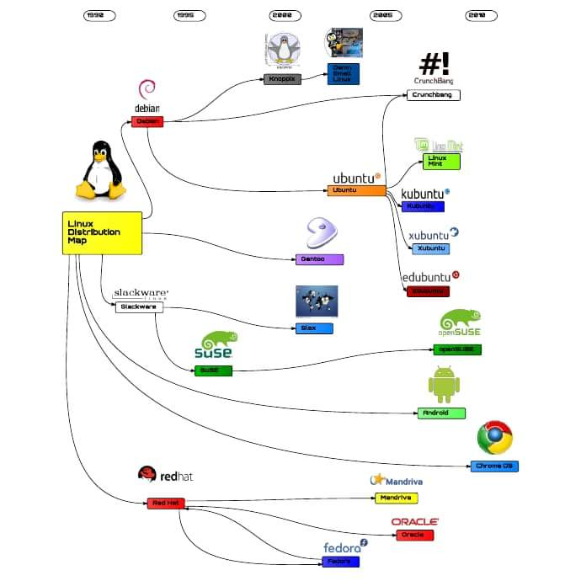
Linux Distributions (Distros)
Few most famous distros
RedHat
Ubuntu
SUSE
Debian
Fedora
Arch Linux

Slide 5
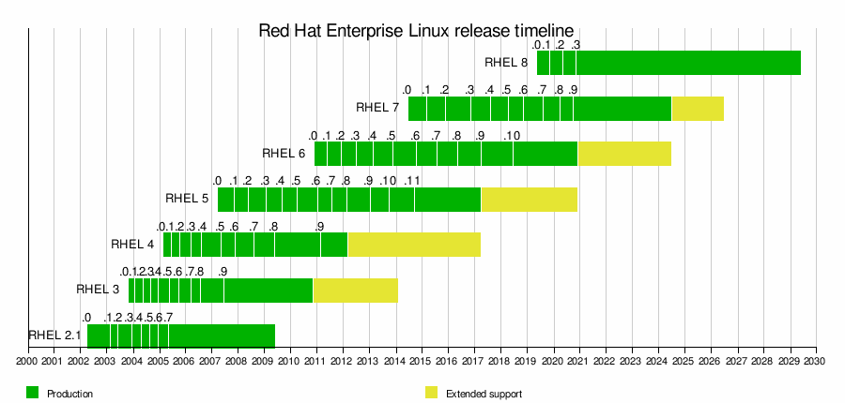
RedHat Enterprise Linux (RHEL)
RedHat is a commercial Linux distribution
Marc Ewing creates first RedHat Linux distribution in 1994
First version of RHEL version 2.1 was released in 2002
Current and Latest version available is RHEL 8.3
In 2019 IBM acquired RedHat for $34 Billion
Red Hat is the clear Linux market leader, with a 67% share in terms of market presence

Slide 6
Systems Administration
Administering the system?
Keep the system up in a consistent state
Monitor performance
User management
Security
Install, configure, upgrade, maintain
Backup, restore, disaster recovery
Application hosting and maintenance

Slide 7
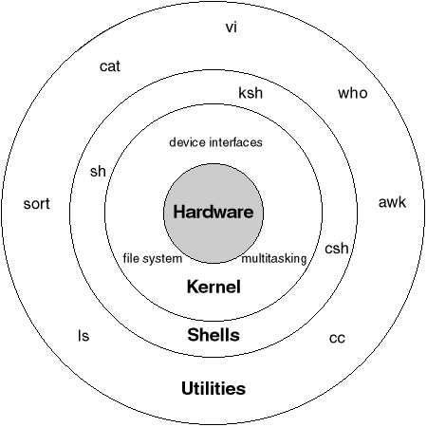
Linux Architecture
Hardware
Kernel
Shell
Utilities

Slide 8
Kernel
The kernel is a computer program that is the core of a computer’s operating system, with complete control over everything in the system. It manages following resources of the Linux system.
File management
Process management
I/O management
Memory management
Device management etc.

Slide 9
Shell
A shell is special user program which provide an interface to user to use operating system services. Shell accept human readable commands from user and convert them into something which kernel can understand. It is a command language interpreter that execute commands read from input devices such as keyboards or from files. The shell gets started when the user logs in or start the terminal.
Command line shell
Example: sh, bash, csh, csh
Graphical Shell (We simply call it Graphical User Interface or GUI)
Example: KDE, GNOME

Slide 10
Utilities
Any third-party software, application or tools installed on the Linux. Utilities interfaces with shell. Few applications can bypass and directly access Kernel.
Example:
cat command
httpd/apache
ftpd

Slide 11
Features of bash shell
Command line completion
Use tab to autocomplete the commands
Wild cards
Wild card characters like * ? ^ etc
Command History
Maintains run/executed command history
Aliases
Allows to create alias for lengthy command
Example: alisas ll=‘ls –l’

Slide 12
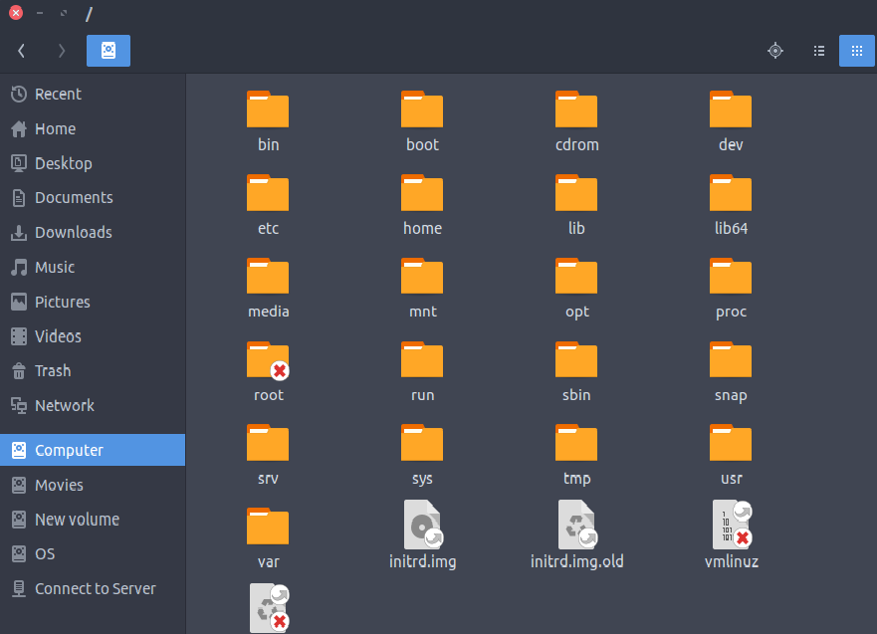
Linux File Structure Linux file system structure is defined under FHS (filesystem hierarchy) by Linux Foundation
/ – The Root Directory
/boot – Static Boot Files
/usr – User Binaries & Read-Only Data
/etc – Configuration Files
/dev – Device Files
/home – Home Folders
/bin – Essential User Binaries
/lib – Essential Shared Libraries
/mnt – Temporary Mount Points
/opt – Optional Packages
/proc – Kernel & Process Files
/sbin – System Administration Binaries
/var – Variable Data Files
/tmp – Temporary Files

Slide 13
